Slide 1
Custom CUDA Kernel for GCN with PyTorch & PyBind
Aarthy Ramesh (A59005333)

Slide 2
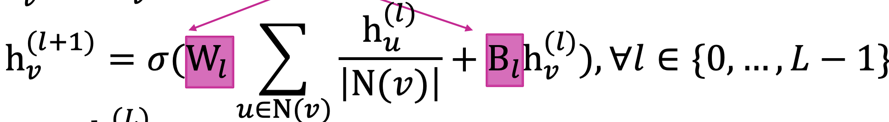
Graph Convolutional Network
Why Graph Convolutional Networks?
Learn representations that take the structure into account for complex domains
Other DL methods don’t work with arbitrary size and complex topological structure of graphs
Useful for node classification, link prediction, community detection.etc
What are GCNs - A comparison with CNNs
Transform information from the neighbors and aggregate
Similar to CNNs, deeper layers get information from further nodes i.e. Layer-N embedding gets information from nodes that are N hops away
*Equation images from http://snap.stanford.edu/class/cs224w-2020/slides/06-GNN1.pdf
Notes:
GCN is the concept of CNN extended to apply to graphs - aggregate information from neighbors - There is no fixed notion of locality or sliding window on the graph
What are GCNs and their relevance - node embeddings for classification
CNN vs GCN - operation
GCN - equation - picture and matrix form
CNN vs GCN in terms of computation

Slide 3
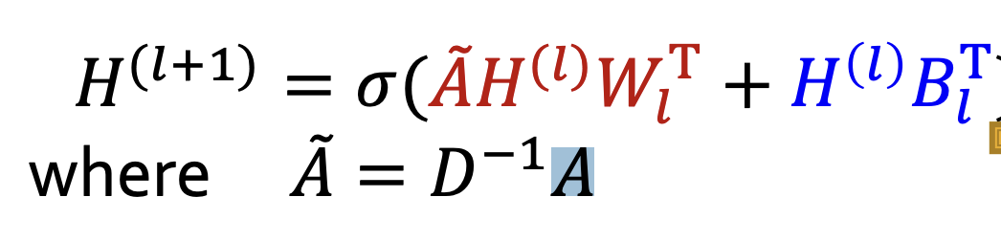
Stages of GCN
Combination - Linear layer i.e. dense matrix multiplication and non-linearity
Aggregation - Sparse matrix multiplication between A and H
Graph Processing - Finding degree matrix & any necessary graph transforms

Slide 4
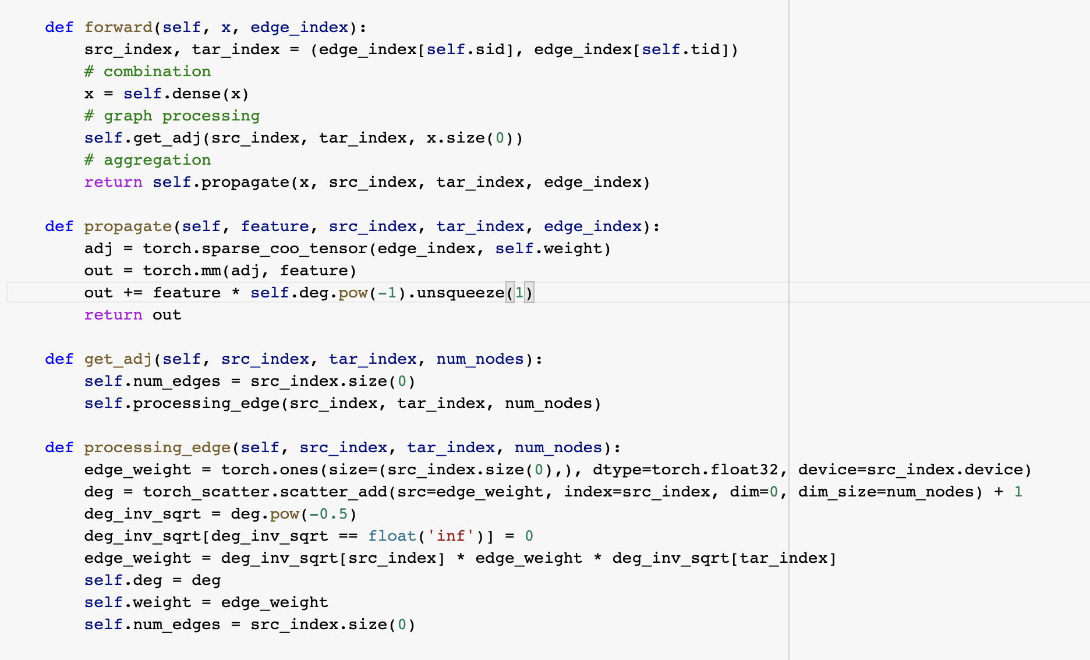
Stages of GCN - SpMM with torch and cuSparse

Slide 5
Sparse Matrix Multiplication
Matrix storage formats
CSR (Compressed Sparse Row) format - row_ptr, columns of non-zeroes, and matrix values
ELL (Ellpack-Itpack) - assumes that each row contains at most elements in rows elements and elements in rows is small. All rows are zero-padded to that value.
COO (coordinate matrix format) - For each non-zero value, stores it’s column and row indices.
PyGeometric
Graph DL library on PyTorch

Slide 6
SpMM COO format - Algorithm
For each (src_node, target_node) in the non-zero edges list:
For each (i,feature) in feature_vector[target_node]:
Temp = feature * edge weight
Output[source_node][i] += Temp
To parallelize,
Each feature element can be assigned to a thread
Each block can deal with one edge or more depending on length of feature vector
To ensure, the summation over output is accurate, use atomicAdd

Slide 7
SpMM - CUDA operation
Num_features (=2) <= threads_in_block (=4)
Small feature size - uncoalesced access
src_edges
B1 |  | B2 |  | B3 |  | B4
features
edge_weight
agg_output
src_edges
tar_edges
nodes
0
1
2
3
t2 | t3
t0 | t1
t0,t2 | t1,t3
1
1
2
3
*
atomicAdd
2
1
3

Slide 8
Num_features (=8) > threads_in_block (=4)
src_edges
B1 | B2 | B3 | B4 | B5 | B6 | B7 | B8
Large feature size - better performance
src_edges
tar_edges
1
2
features
edge_weight
agg_output
nodes
0
1
2
3
t0 | t1 | t2 | t3 | t0 | t1 | t2 | t3
t0 | t1 | t2 | t3 | t0 | t1 | t2 | t3
*
atomicAdd

Slide 9
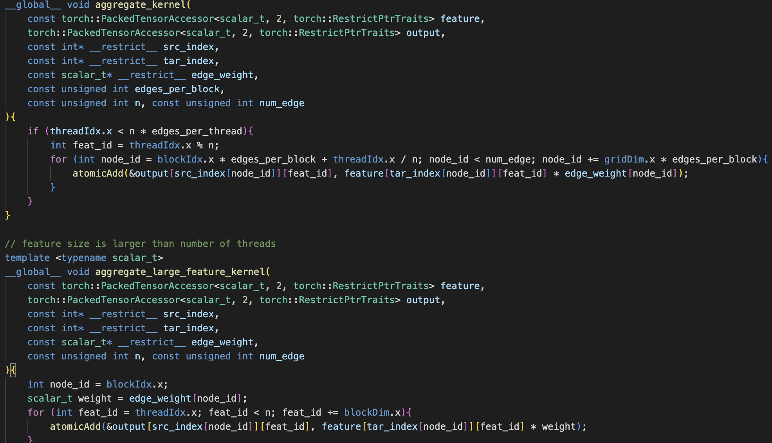
SpMM - CUDA code
Notes:
Backward kernel is the same in the opposite direction of accumulation because we’re not computing gradient of edge weights

Slide 10
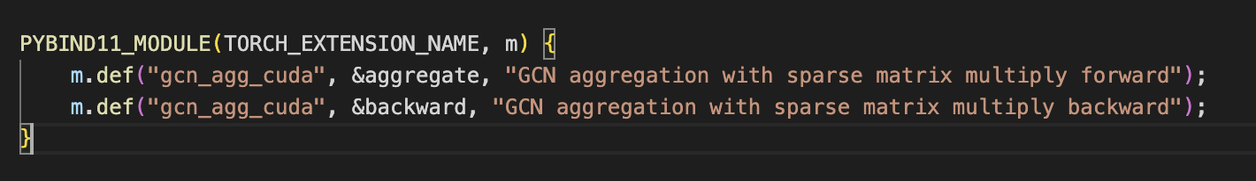
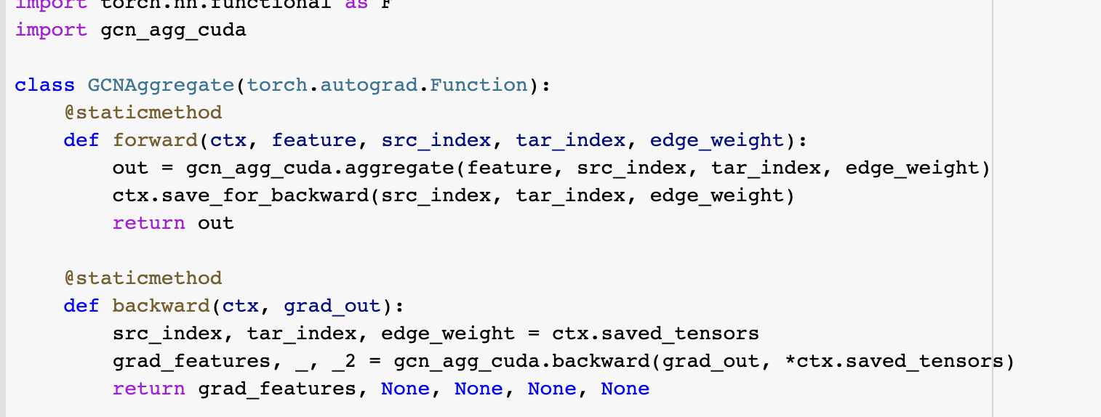
Integration with PyG & PyTorch via PyBind
PyBind - allows C++/CUDA to be imported in Python project
Custom module used in torch function

Slide 11
Future Directions
CSR sparse multiplication is faster if we can implement an efficient kernel to convert between matrix storage types
COO - atomic operations are slow
Fused kernel for graph processing along with aggregation

Slide 12
References
http://snap.stanford.edu/class/cs224w-2020/slides/06-GNN1.pdf (GCN theory)
https://seal.ece.ucsb.edu/sites/default/files/publications/fusegcn_camera_ready_.pdf (GCN GPU implementation methods)
https://medium.com/analytics-vidhya/sparse-matrix-vector-multiplication-with-cuda-42d191878e8f (SpVM kernel implementations)
https://pytorch.org/tutorials/advanced/cpp_extension.html (PyTorch C++/CUDA extensions)
https://pytorch-geometric.readthedocs.io/en/latest/_modules/torch_geometric/nn/conv/gcn_conv.html#GCNConv (PyGeometric - GCN library with a similar design)

